Slide 1


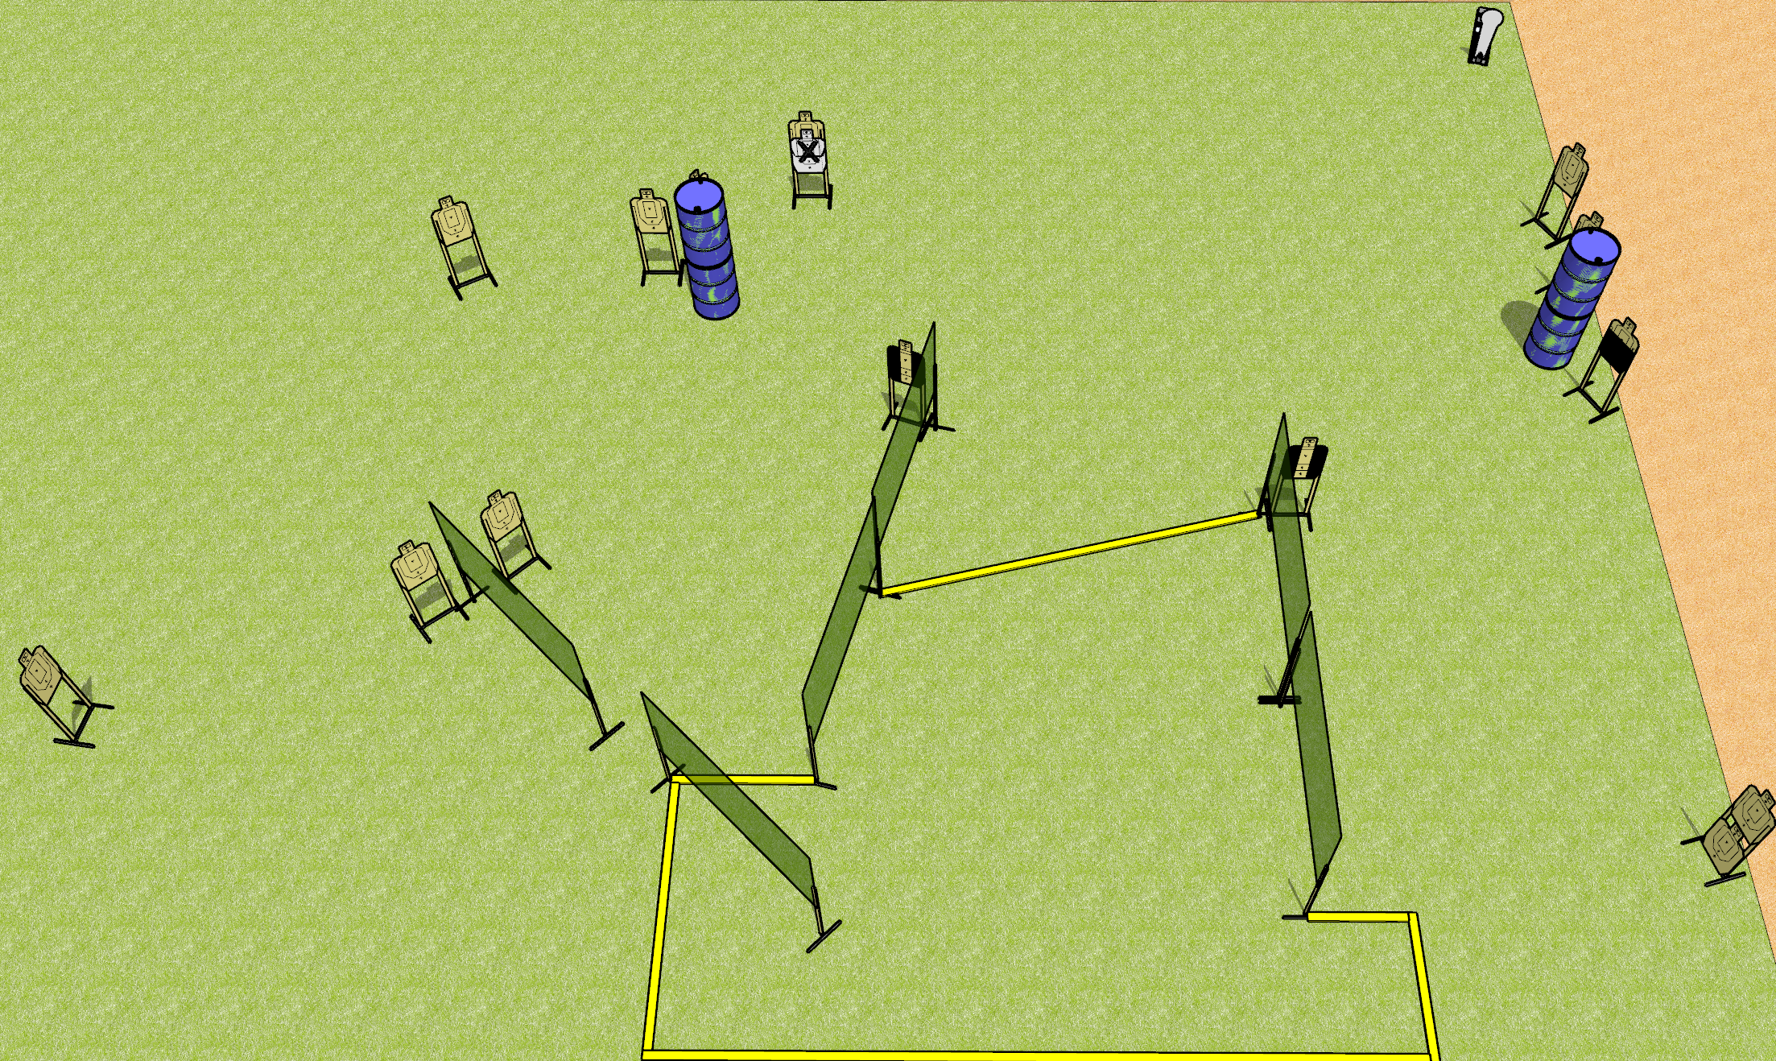
 | Dothan Gun Club – USPSA Match Angled Course Designer : Drew Coleman
START POSITION : Inside shooting area, heels against rear fault line, wrists below belt
GUN READY CONDITION : Pistol unloaded and holstered. PCC unloaded, held with both hands, stock on belt. |  | SCORING: Comstock, 29 rounds TARGETS: 14 paper, 1 Steel SCORED HITS: Best 2 on paper, steel until down START-STOP: Audible, last shot RULES:
STAGE PROCEDURE: Engage targets as they become available from within the fault lines.

Slide 2
Angled
Written Stage Briefing
Angled is a 29 round, 145 point, Comstock field course. There are fourteen USPSA targets and one Colt popper. The best two hits on paper will score and steel must fall to score. The start signal is audible.
Handgun start position is inside the shooting area, heels against rear fault line, wrists below belt. Handgun is unloaded and holstered.
PCC start position is inside the shooting area, heels against rear fault line. Unloaded carbine is held with both hands, stock on belt.
On start signal, engage targets as they become available from within the shooting area.

